Slide 1




REAL-TIME
SPEECH RECOGNITION & TRANSLATION

Slide 2
TEAM MEMBERS
Amir Ezzat
Reham Bassiouny
Mosatafa Hamada
Abanob Eskandar
Ahmed Anwar

Slide 3
AGENDA
Project Overview
Project Timeline
01
02
Data Collection & Preprocessing
Dataset Insights
03
04
Modeling Phase & Challenges Faces
Challenges Solution & Fine Tuning Pre-Trained Model
05
06
Final Result & Future Work
Model Deployment
07
08

Slide 4
PROJECT OVERVIEW
Goal
Focus areas
Technologies
Build a real-time system that recognizes speech and translates it into different languages.
Data collection and preprocessing.
Model training and fine-tuning.
Deployment and API development.
Python
Hugging Face Transformers
FastAPI.

Slide 5
PROJECT TIMELINE
Week 1
Week 2
Week 3
Data Collection and Preprocessing.
Speech Recognition and Translation Model Development.
Advanced Techniques (FastAPI)

Slide 6
DATA COLLECTION & PREPROCESSING
Collected approximately 3000+ MP3 audio files.
Converted all files into WAV format using Librosa and SoundFile libraries.
Target sample rate: 16kHz to match model requirements.
Maintained clean and structured folder organization for training.
Audio Preprocessing and Feature Extraction
Cleaned the audio by:
Trimming silence.
Normalizing the audio signals.
Extracted Mel Spectrograms:
128 Mel bands.
Padded/Truncated to 128 frames.
Created a metadata CSV linking features to transcripts.
Tools used: Librosa, NumPy, Pandas.

Slide 7
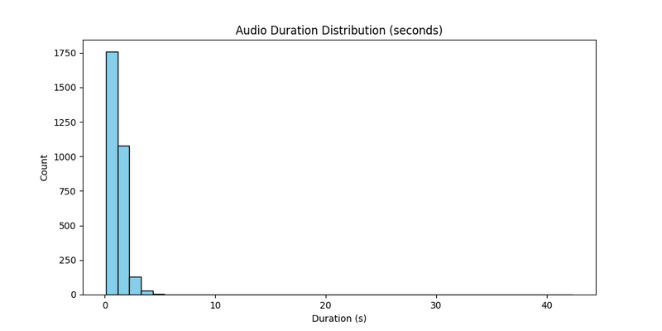
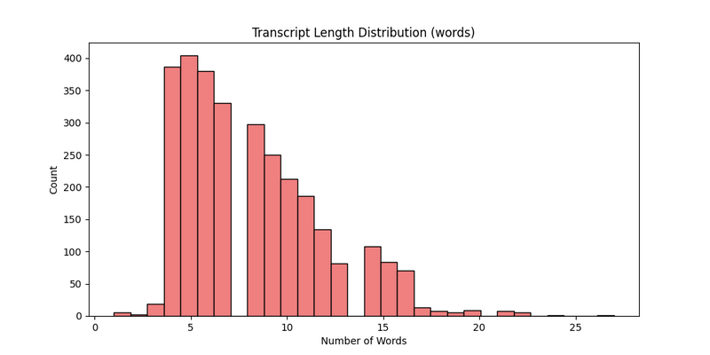
DATASET INSIGHTS & PREPROCESSING REPORT
Duration Histogram
Total Samples: 3005.
Average Duration: 1.25 seconds.
Min-Max Duration: 0.13 sec to 42.33 sec.
Average Transcript Length: 8.19 words.
Transcript Length Histogram

Slide 8
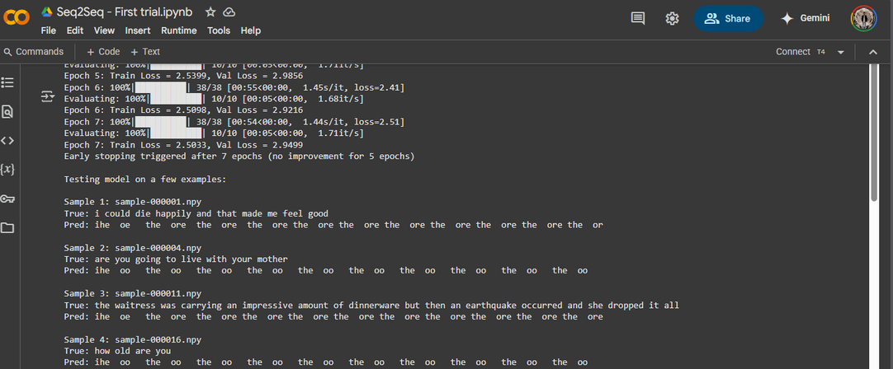
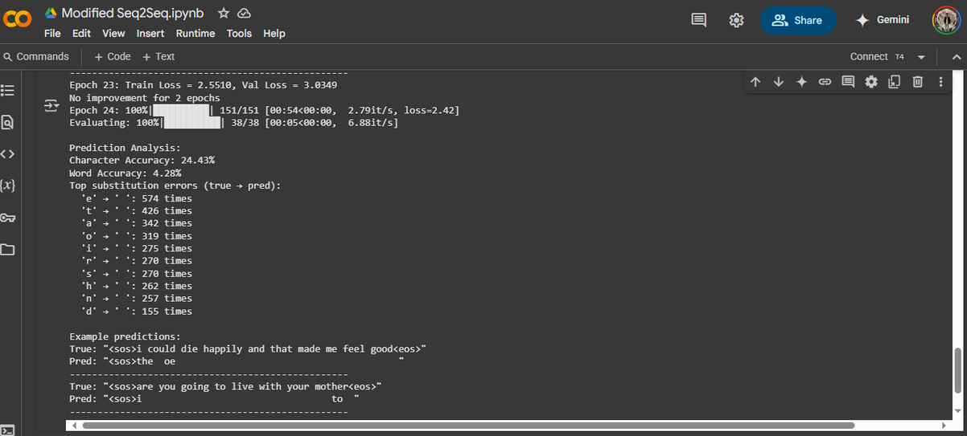
MODELING PHASE & CHALLENGES FACED
Building a Custom Model
Designed a Seq2Seq with Attention model architecture:
Bidirectional LSTM Encoder.
Attention-enhanced LSTM Decoder.
Implemented full training and evaluation pipelines.
Early stopping and learning rate schedulers added.
Changing the hyperparameters of a Seq2Seq model to improve the accuracy & the prediction

Slide 9
CHALLENES FACED
01
Limited computational resources (Colab GPU constraints).
03
Long training times without significant convergence.
02
Insufficient dataset size for deep learning training.
04
Memory bottlenecks during model evaluation.

Slide 10
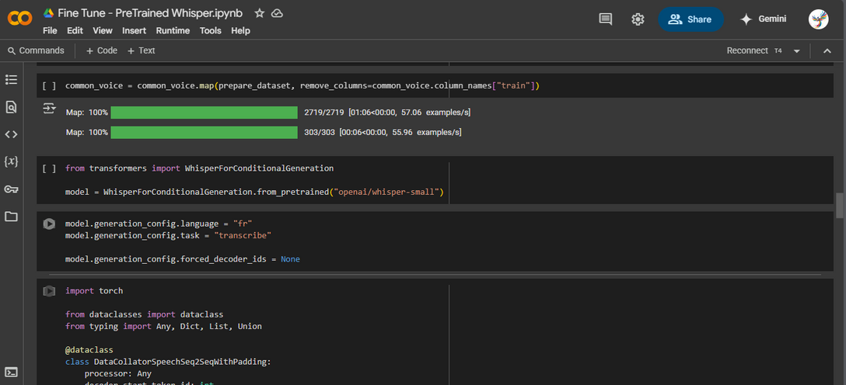
CHALLENGES SOLUTION
Switch to Pre-trained Model
Adopted the Whisper-small pre-trained model from Hugging Face.
Fine-tuned Whisper on custom dataset using limited resources.
Focused on:
Efficient training with low batch size and gradient accumulation.
Faster convergence with small data.

Slide 11
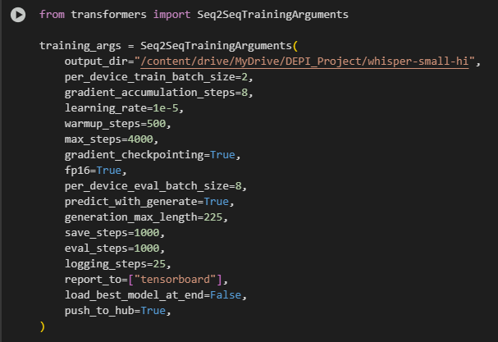
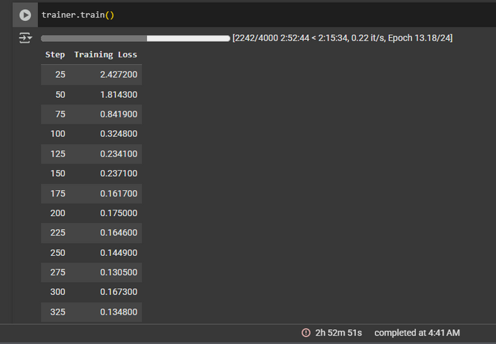
FINE TUNING PRE-TRAINED MODEL
Fine-tuning Strategy
Data Preparation:
Custom DatasetDict with audio and text.
Preprocessing:
Used WhisperFeatureExtractor, WhisperTokenizer, WhisperProcessor.
Training Strategy:
Mixed precision (fp16).
WER (Word Error Rate) used for evaluation.
Optimized hyperparameters for fast convergence.
Starting the training process until we reached 2000 steps with training loss 0.001500 (Until Free Colab GPU Expired)

Slide 12
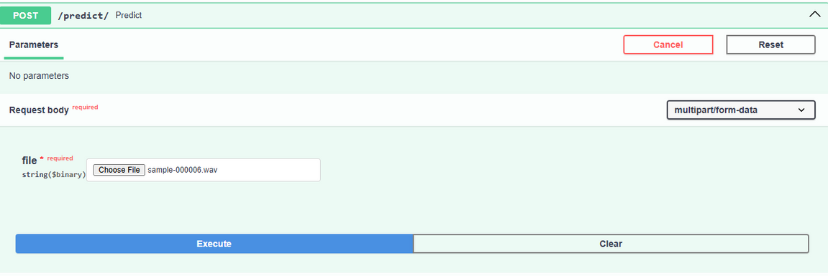
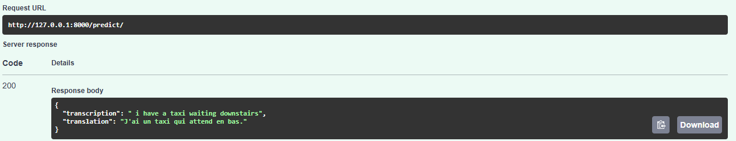
MODEL DEPLOYMENT
API Development with FastAPI
Developed a FastAPI service to:
Upload audio.
Transcribe speech using Whisper.
Translate text using Helsinki-NLP translation model.
Real-time predictions and responses in JSON format.
Secured file upload and validated audio inputs.

Slide 13
FINAL RESULT
01
Working system for real-time speech recognition and translation.
03
Successful integration into an easy-to-use REST API.
02
Reliable transcription and translation performance.
04
Demonstrated full cycle from raw audio to translated text.

Slide 14
FUTURE WORK
01
Support for more languages and dialects.
03
Full Azure cloud deployment with load balancing.
02
Incorporate speaker identification and noise robustness.
04
Extend translation capabilities to broader contexts.

Slide 15
Questions and Discussions
Thank You!

